Slide 1

Ideals Crew: Al Chatbot Solution Type: Prototype
Sneha Pandey (Team Lead)
Philippa Burgess
Yash Padhara
Krishna Vamsi Regulavalasa
Notes:
Korrie

Slide 2
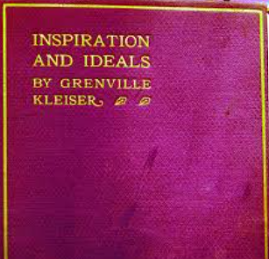
The Opportunity: Bringing Timeless Wisdom to a Modern Audience
How we feel often determines our attention, motivation, and actions. Those activities over our lifetime build our community, opportunities and character – which leads to outcomes across our professional, family, and personal lives that can impact generations.
Feelings are internalized and processed by mindset, values and resilience.
Therefore, daily inspirations that guide us to develop our emotional and
spiritual selves have value.
Emotional fatigue and digital overload are rising
Daily wellness tools are often shallow or impersonal
AI offers scalable support—but tone and content matter
We saw potential in a 100-year-old motivational text—made interactive
The book Inspiration and Ideals: Thoughts for Every Day was published in 1917 by Yale University, School of Divinity Professor Grenville Kleiser and is in the public domain. It was refreshed by team member Philippa Burgess, and in early 2025 created as a daily Substack.
Notes:
Korrie
updated 7/21

Slide 3
Solution: AI-Powered Inspiration
Why We Built It People need encouragement, but most chatbots offer canned, impersonal advice. We wanted to combine emotional intelligence with emerging tech to create something warm, wise, and accessible.
What We Created
365 motivational entries digitized and adapted from Philippa Burgess’ update of the 1917 public domain text
Curated for inclusive tone—spiritually grounded, not religious
Delivered through Microsoft copilot studio
Built entirely on Microsoft tools
What Sets Us Apart
Ethical, human-centered AI for emotional purpose, affirmation and resilience
Curated—not generated—content: timeless wisdom with a modern voice
Scalable and customizable to be integrated into various web or app experiences.
Designed to inspire and engage, not just respond
Notes:
Korrie
updated 7/21

Slide 4




Demo
Notes:
Korrie
updated 7/21

Slide 5
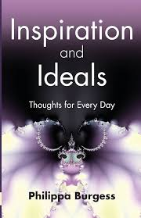
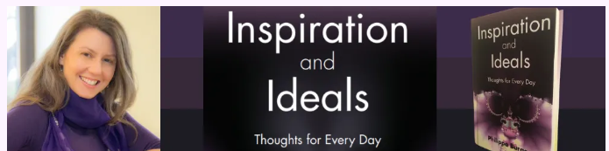
Takeaways: Making Wisdom Work for You
Wrap-up Reflections
Stop relying on one-size-fits-all AI for meaningful motivation
Start designing tools that combine emotional intelligence with structured data
Without thoughtful curation, bots often miss the human connection
Our process simplified content digitization using Microsoft tools
Power Platform helped us build quickly, test ideas, and iterate with clarity
Notes:
Korrie
updated 7/21

